Slide 1
Modeling transport through a porous electrode
Rosa Zhang, A. Chowdhury, C.J. Radke, A.Z. Weber
May 18th, 2021
Notes:
https://docs.google.com/document/d/1SRnpa6Rq8FfIDpHr8cFOuFllTG70-UcGAEj1zerWnAs/edit?usp=sharing

Slide 2
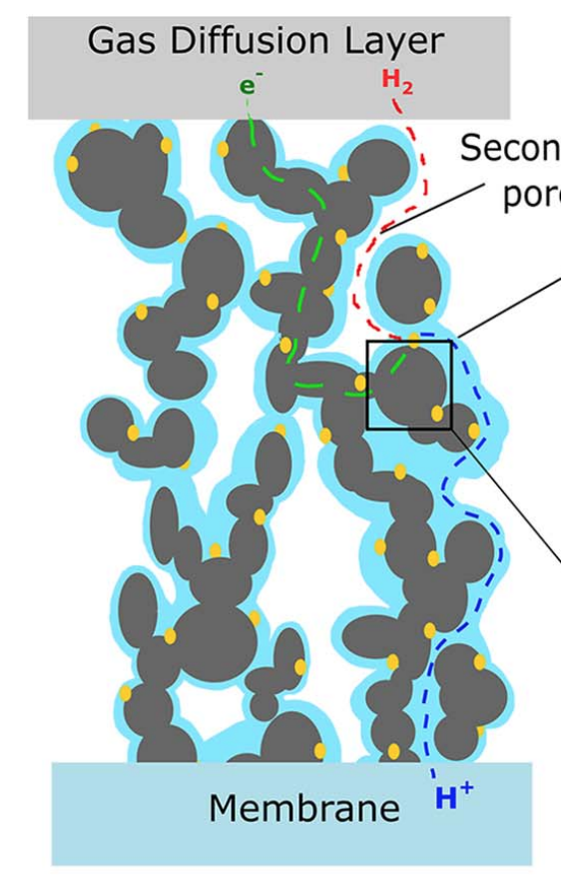
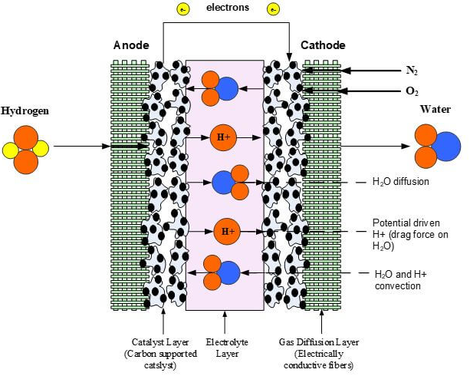
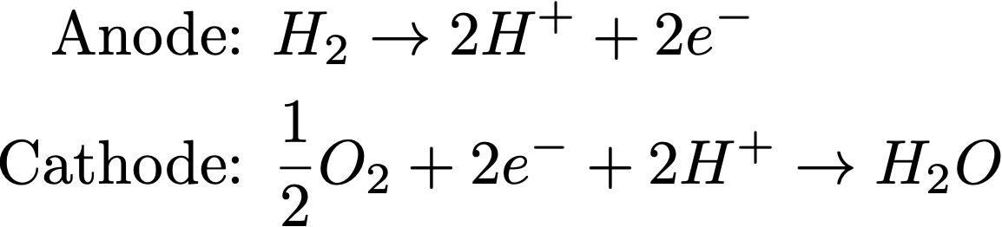
Gas transport into the catalyst layer
Diffusion through CL moves through multiple phases and length-scales.
We model these different regions to understand how they affect overall current output and implications for Pt utilization.
Figure 1. Illustration of fuel cell.
Figure 2. Illustration of CL structure.²
Notes:
Gas transport in catalyst layer
CL looks like this, gas transport throu, model this process

Slide 3
Interacting components of model
CL gas transport
Electrode bulk transport
Agglomerate- scale transport
Combined
Notes:
To understand this model, we take a look at the CL bulk model
Gas transport in catalyst layer
CL looks like this, gas transport throu, model this process

Slide 4
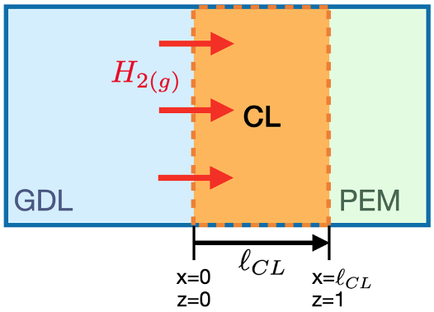
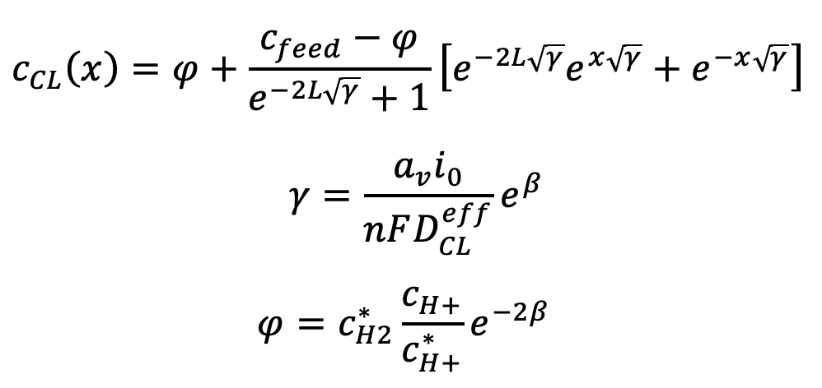
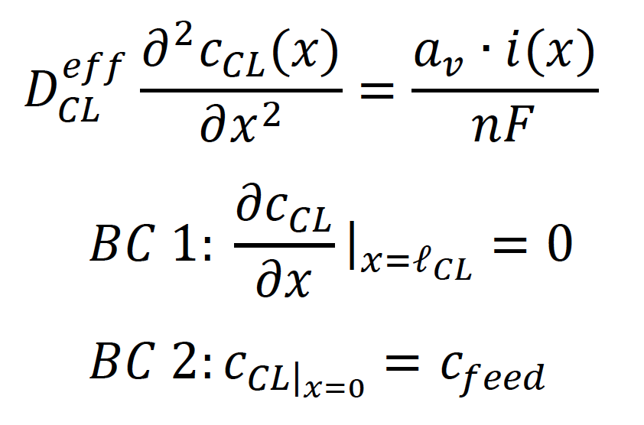
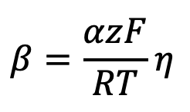
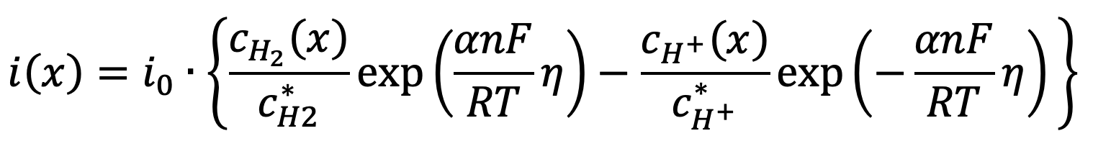
Electrode (CL) bulk model
Governing equation
Butler-Volmer kinetics
Figure 2. Boundaries for dimensionless 1-D flow in bulk model. Computational model is restricted to the CL only, shown in the orange dashed-line boundaries.
Notes:
BV is applicable at Pt site; emphasize that this is corrected later w the agglomerate model

Slide 5
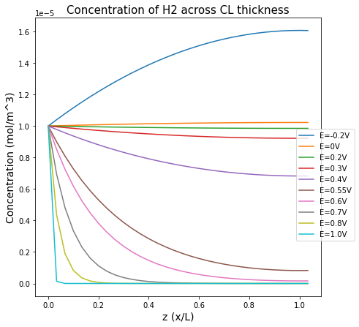
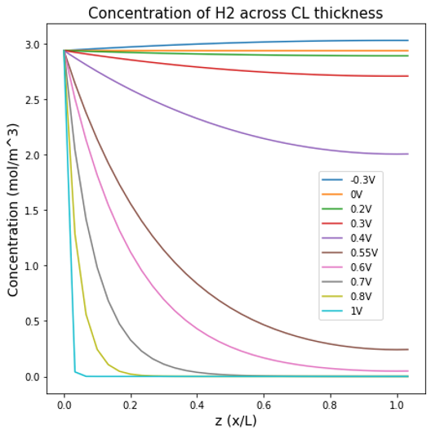
Bulk (CL-thickness) model
Left: 0.1 of original concentration for feed
At high overpotentials,
Poor Pt utilisation
(Low conc of H2)
Negative overpotential has more drastic effect on backwards reaction.
Other trends remain similar.
Figure 4. Concentration at 10% of 1000ppm (right plot) versus relative distance from start of CL thickness.
Figure 3. Concentration versus relative distance from start of CL thickness in bulk model.
Notes:
At higher overpotential, poor Pt utilisation

Slide 6
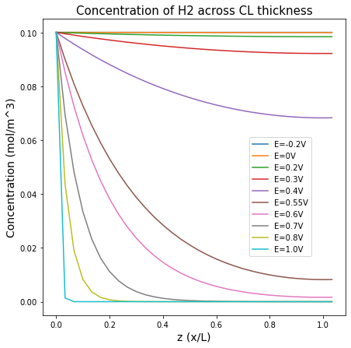
Bulk (CL-thickness) model
Notes:
Right plot: Show various concentration for c_feed in 0.2, 0.3, 0.4 V

Slide 7
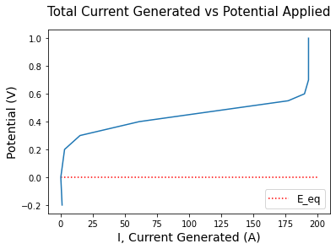
Transport vs Ohmic vs Kinetic Limited Regimes
Kinetic (Reaction Rate) Limited
E < +0.2V
Ohmic Losses
E < +0.2V < +0.6V
Transport Limited
E < +0.6V
Figure 6. Coulomb/second generated vs applied potential.
Notes:
Potential = y-axis
Current on x-axis
= polarisation curve

Slide 8
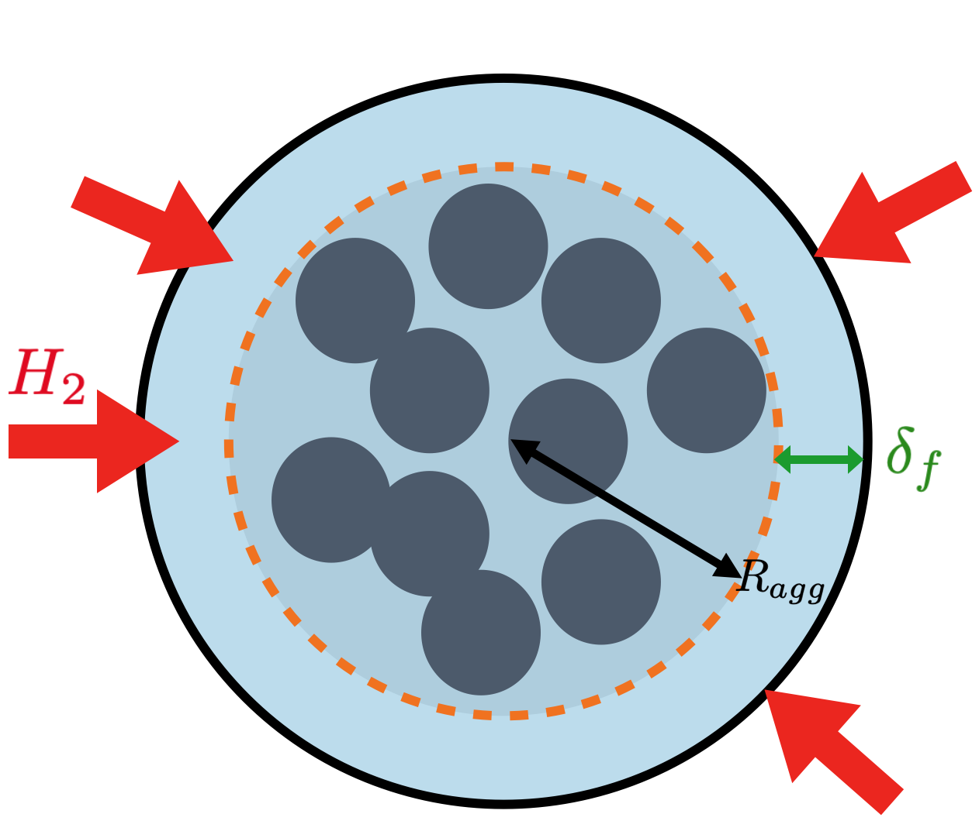
Agglomerate-scale Model
Since no reaction occurs in the film,
Regions must be solved separately.
Agglomerate region (r<R_{agg})
2. Film thickness (r>R_{agg})
Figure 7. Dimensionless 1-D domain used in the agglomerate-scale model, where R_{agg} is the radius of the agglomerate and δ_{f} is the ionomer film thickness.
Notes:
BV is only applicable at Pt surface so we need to know concentration fo H2 at the Pt surface. Gas diffusion thus is impacted by the agglomerate’s surrounding film.

Slide 9
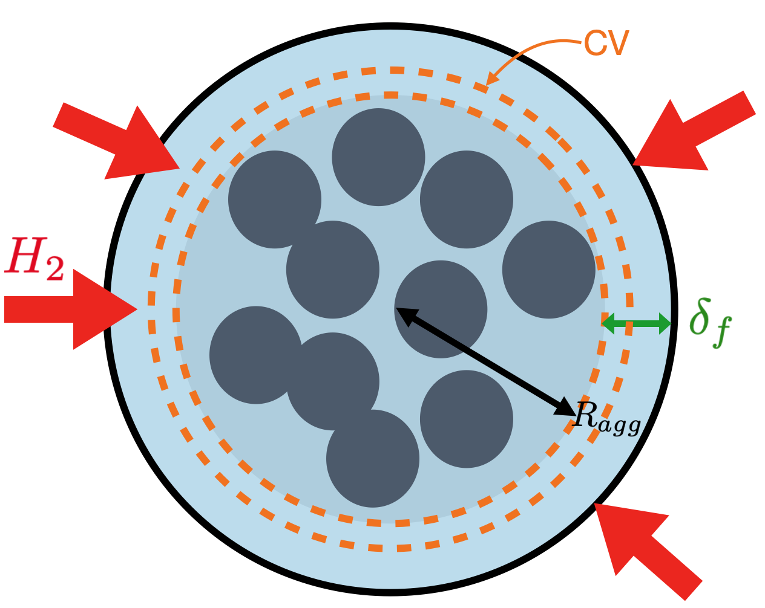

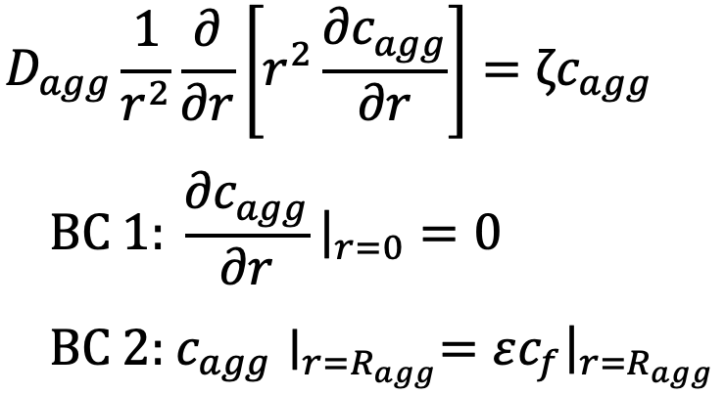
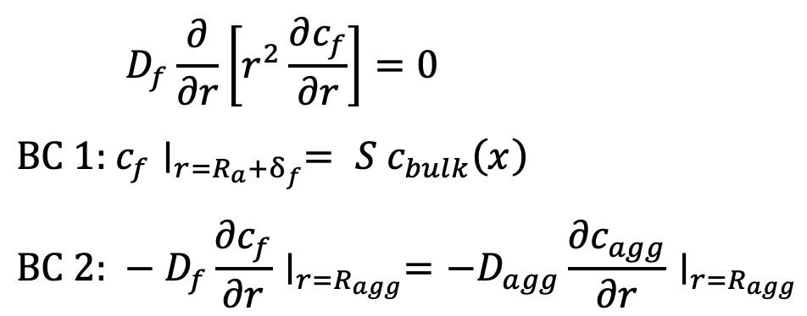
Agglomerate model set-up
Agglomerate region (r<R_{agg})
Film region (R_{agg}+δ_{f} > r > R_{agg})
Figure 8. Control volume used for mass balance to derive governing equations.
Notes:
Using epsilon

Slide 10
Film model set-up
Film region (R_{agg}+δ_{f} > r > R_{agg})
Agglomerate region (r<R_{agg})
Notes:
Equation (22.1) describes the concentration of hydrogen at the surface of the film , which should equal to the bulk concentration in the CL. The second boundary equation (22.2) describes steady state assumption for Fick’s Law. At the film-agglomerate interface , flux leaving the film layer should equal to flux entering the agglomerate. This allows us to rewrite our governing equations and boundary conditions as:

Slide 11
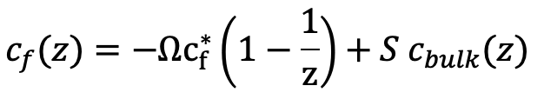
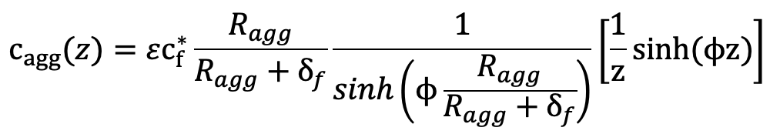
Film model set-up
Film region (R_{agg}+δ_{f} > r > R_{agg})
Agglomerate region (r<R_{agg})
Notes:
Equation (22.1) describes the concentration of hydrogen at the surface of the film , which should equal to the bulk concentration in the CL. The second boundary equation (22.2) describes steady state assumption for Fick’s Law. At the film-agglomerate interface , flux leaving the film layer should equal to flux entering the agglomerate. This allows us to rewrite our governing equations and boundary conditions as:

Slide 12
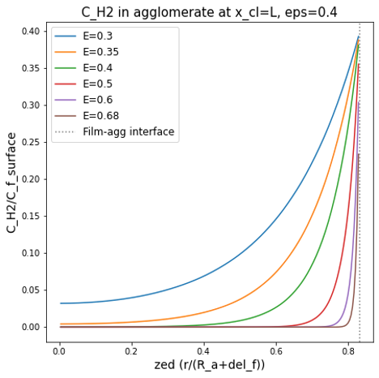
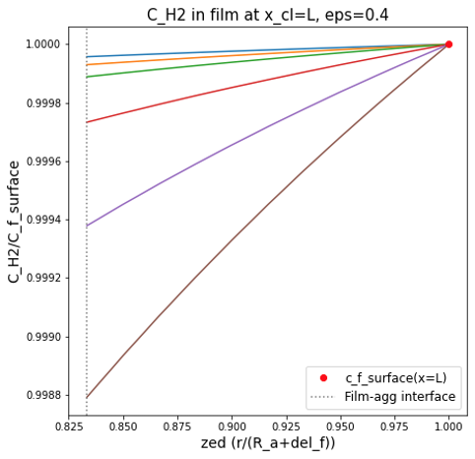
Agglomerate & Film C_{H2} at Varying Overpotential

Slide 13
Conclusions
Bulk model shows that concentration of H2 is higher than reality.
Notes:
Summarise bulk model vs agglom; concentration drops quickly within the agglomerate
Locally at Pt, conc of H2 is much lower
Bulk model: solvation of the gas into the film (S)
Predicts high current since concentration is high; agglom model shows ^ above
Next step: combine models

Slide 14
Conclusions
Next steps
Bulk model predicts concentration of H2 that is higher than reality.
Feed agglomerate model into CL bulk.
Sensitivity analysis of parameters such as:
Agglomerate model considers additional factors that strongly influence concentration.
Agglomerate radius
Film thickness
Ratio of agglomerate volume versus ionomer volume (epsilon)
Ratio of agglomerate volume in CL
These include: solvation of the gas into agglomerate film (S), reduced available volume for reaction (epsilon).
Notes:
Summarise bulk model vs agglom; concentration drops quickly within the agglomerate
Locally at Pt, conc of H2 is much lower
Bulk model: solvation of the gas into the film (S)
Predicts high current since concentration is high; agglom model shows ^ above
Next step: combine models

Slide 15
Works Cited
Acknowledgements
Darling, R.; A Hierarchical Model for Oxygen Transport in Agglomerates in the Cathode Catalyst Layer of a Polymer-Electrolyte Fuel Cell; Journ. of the Electrochem. Soc. 2018, 165(9).
Schuler, T., Chowdhury, A., et al.; Fuel-cell catalyst-layer resistance via hydrogen limiting current measurements; J. of Electrochem. Soc 2019, 166(7)
Yoon, W. & A. Z. Weber.; Modeling low-platinum-loading effects in fuel-cell catalyst layers; J. of Electrochem. Soc. 2018, 158(8).
Thank you to Ana for mentoring me and being a fantastic guide throughout this semester! I sincerely appreciate Aaron He, Dr. Weber, Prof. Radke, and the Weber Group as a whole for supporting me in my work and learning.

Slide 16
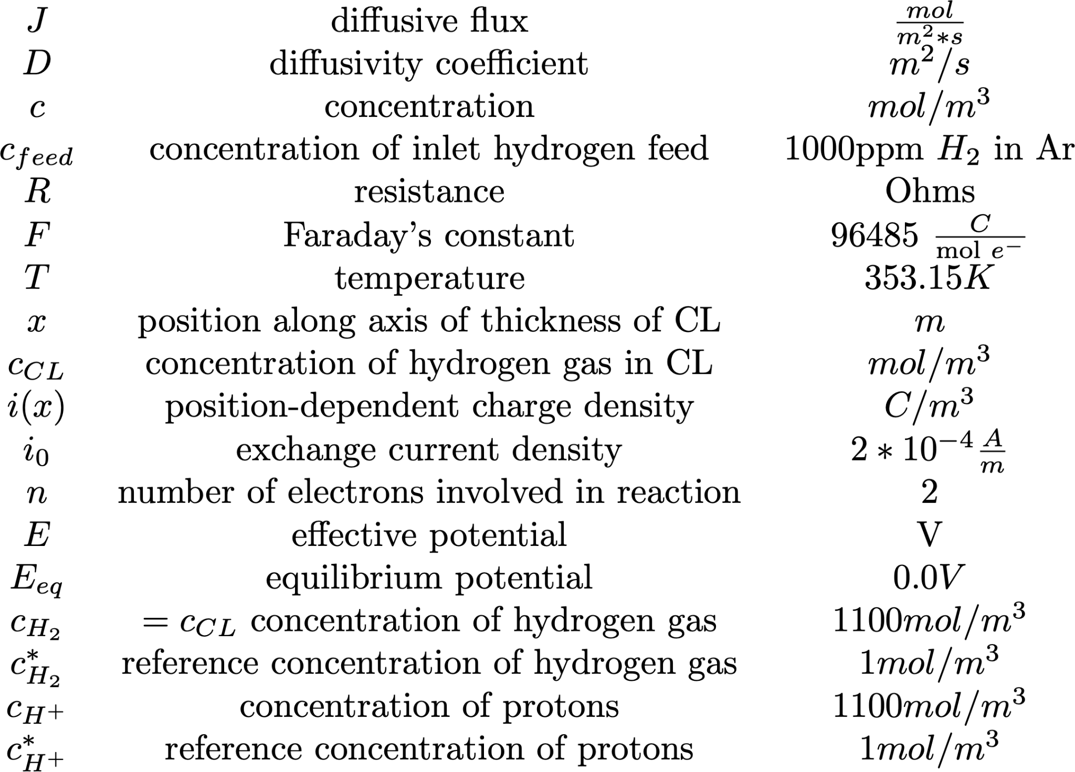
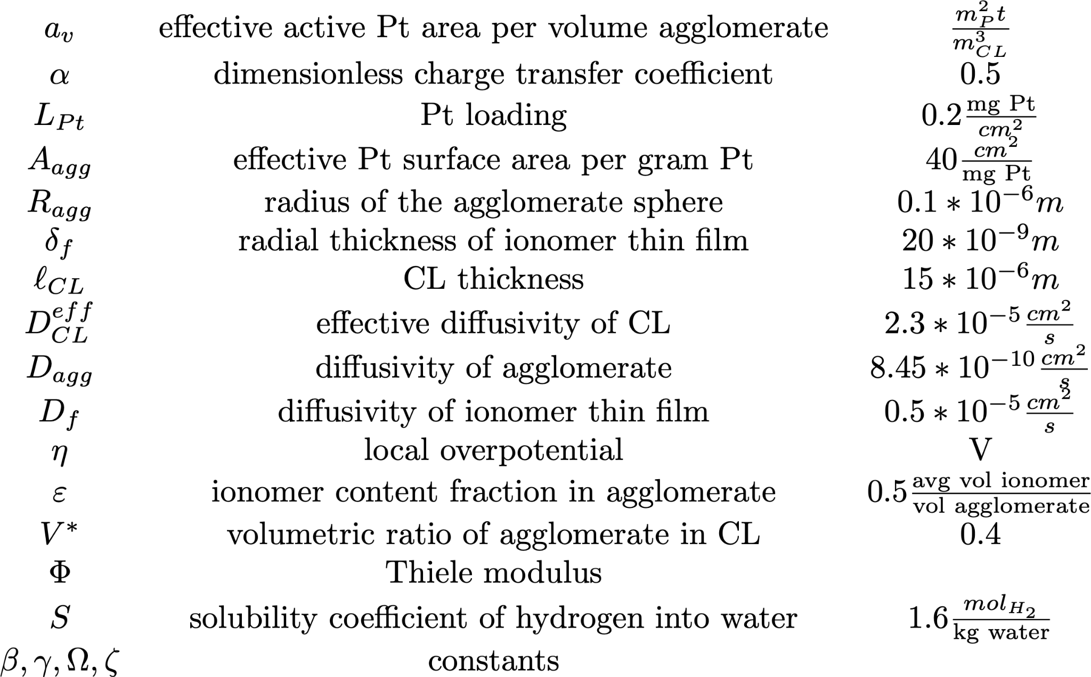
Symbols used
Notes:
New

